Slide 1
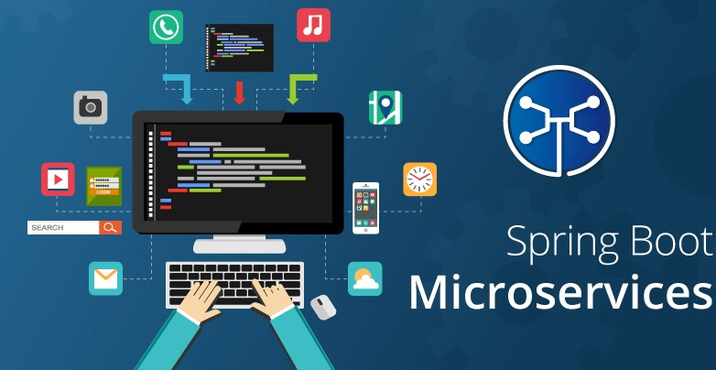
Notes:
Sourabh Notes

Slide 2

Agenda
What is Microservices.
Why Microservices.
Microservices framework for Java.
Spring Boot.
Spring Boot Starters.
Demo on Spring Boot
Challenges With Microservices.
Spring Cloud.
How Spring Clouds resolves microservices challenges.
Demo on Spring Boot microservices with help of Spring Cloud.

Slide 3
What is Microservices ?
Microservices is an architecture pattern wherein applications are built as a collection of various smallest independent service units.
It focuses on decomposing an application into single-function modules.
These modules can be independently deployed and operated.
In this methodology, big applications are divided into smallest independent units.

Slide 4
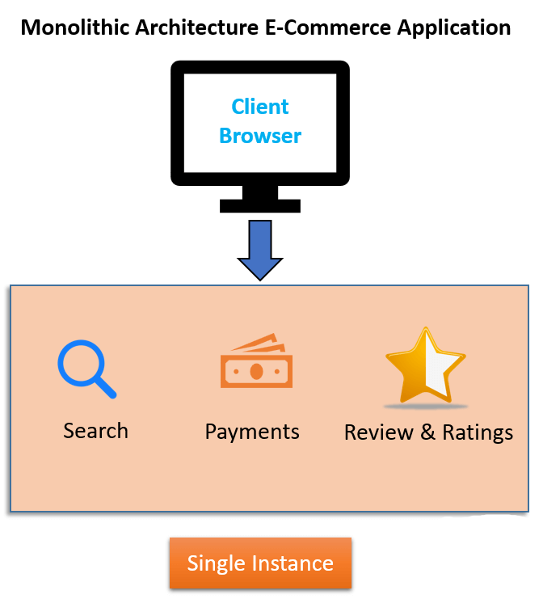
Why Microservices?
Monolithic architecture is like a big container in which all the software components of an application are clubbed into a single package.
If any specific feature is not working, the complete system goes down. In order to handle this issue, the application needs to re-built, re-tested and also re-deployed.
Data is centralized.
Change in data model affects the entire database.
One function or program depends on others.

Slide 5
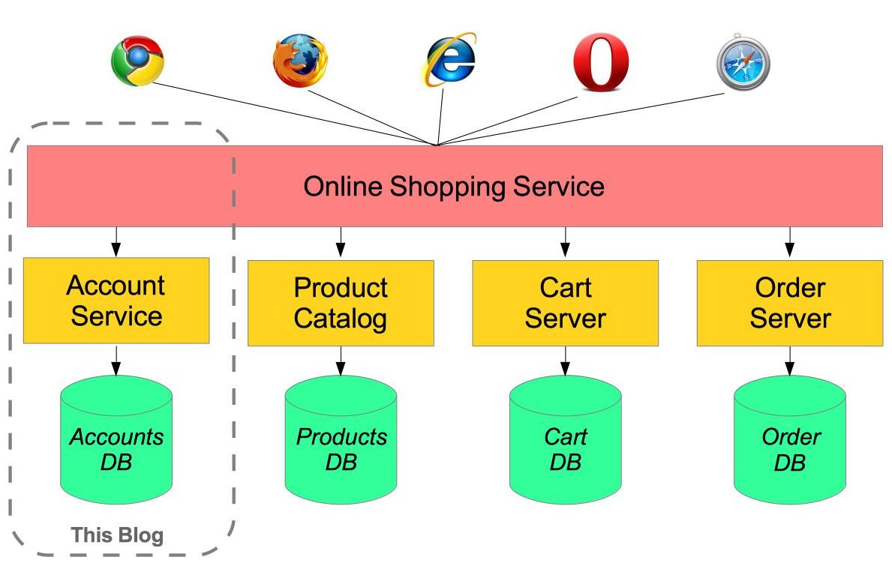
Why Microservices ?
Microservice Architecture is an architectural development style which allows building an application as a collection of small autonomous services developed for a business domain.
Even if one service goes down, other can continue to function.
Data is federated.
Change in the data model of one Microservice does not affect other Microservices.
You can use different technologies for different Microservices.
Notes:
Data is federated. This allows individual Microservice to adopt a data model best suited for its needs.

Slide 6




Microservices framework for Java
Spring Boot
Jersey
Spark
Dropwizard
Play Framework
Etc.

Slide 7
Spring Boot
It provides RAD (Rapid Application Development) feature to the Spring framework.
It is having starter templates features.
Resolving dependency conflict.
It has information of compatible version for all dependencies.
It provides embedded HTTP server Tomcat etc.
Everything is auto configured
Annotation-based spring application.
Notes:
Resolving dependency conflict. It identifies required dependencies and import them for you.
In Spring Boot, everything is auto configured; no manual configurations are needed.

Slide 8
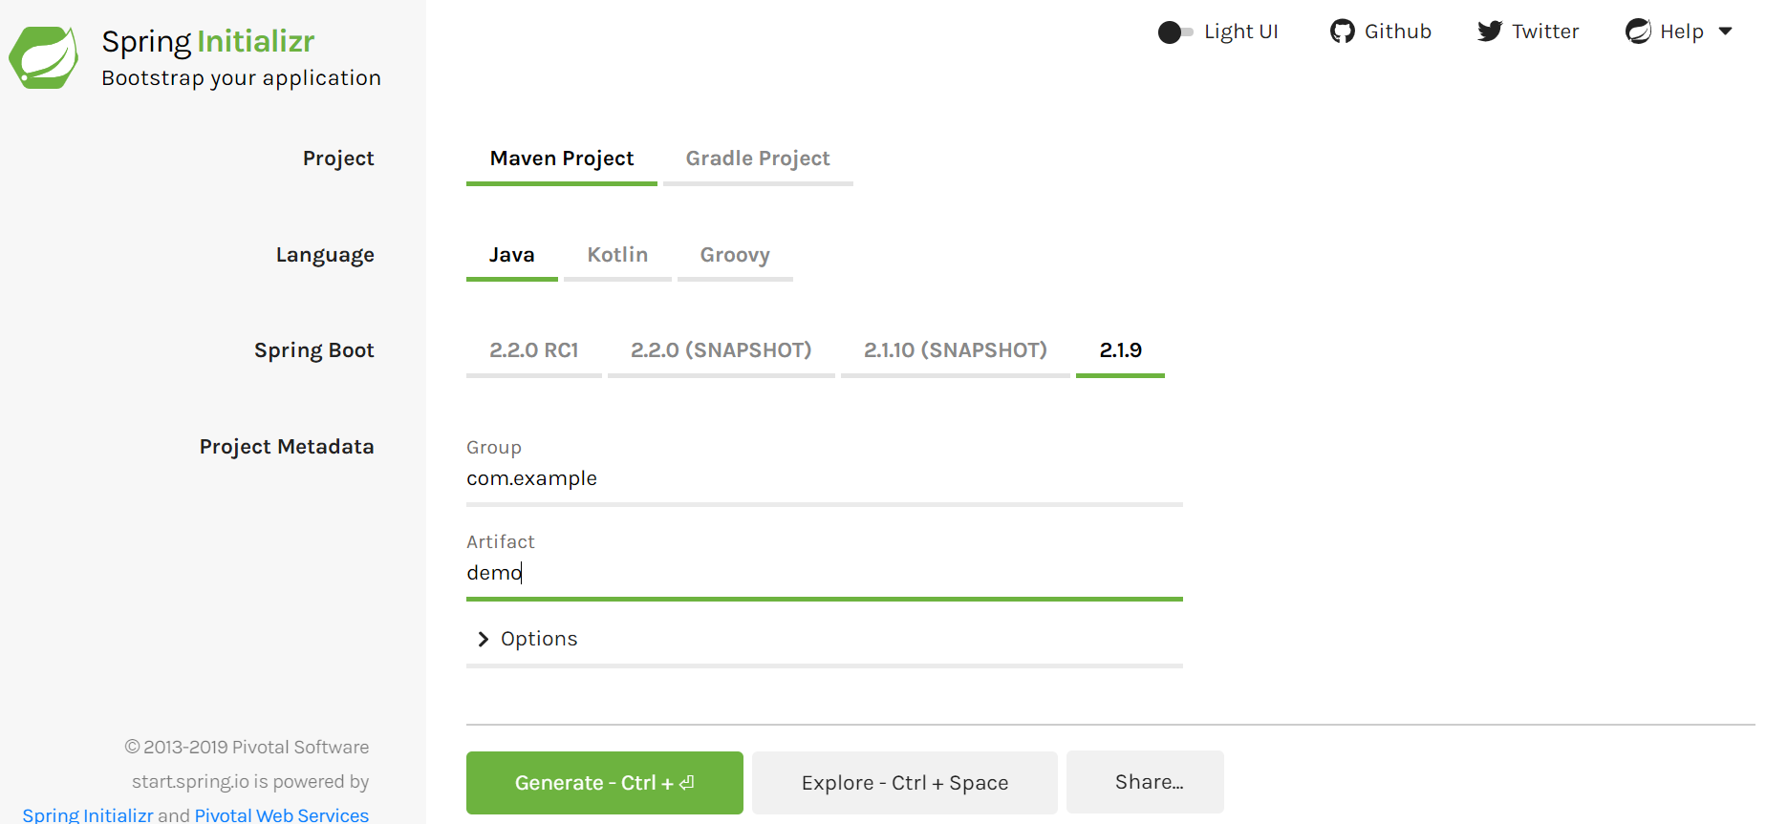
Spring Boot Starters
Spring Boot resolves problem of handling dependency management by providing a set of dependencies for developers convenience.
Spring Boot Starter Actuator dependency : It is used to monitor and manage your application.
Spring Boot Starter web dependency : It is used to write Web & RESTful applications.
Spring Boot Starter JDBC dependency : Traditional JDBC
Spring Boot Starter Security dependency : Authentication and Authorization using Spring Security.
Spring Boot Starter Data JPA dependency : Spring Data JPA with Hibernate.
Spring Boot Starter Hateoas : Make your services more RESTful by adding HATEOAS features.
Notes:
Spring HATEOAS(Hypermedia as the Engine of Application State)

Slide 9
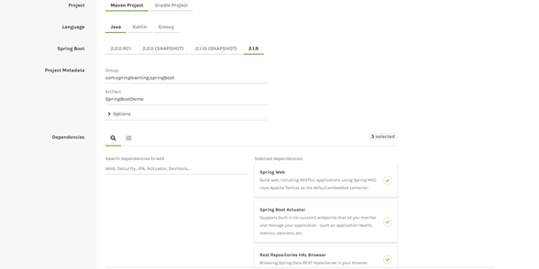
Demo On Spring Boot
Go to https://start.spring.io/
Select language, version of Spring Boot and dependency as per business.
Notes:
Spring HATEOAS(Hypermedia as the Engine of Application State)

Slide 10
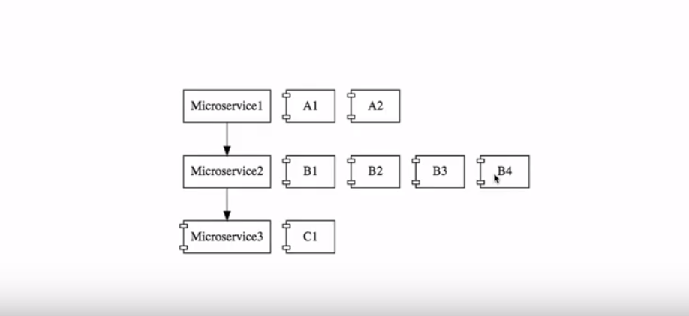
Challenges with Microservices
Configuration Management: There will be n no of microservices u will build but need to take care how to manage those.
Dynamic Scale Up and Scale Down: We should able to dynamically distribute the load across the instance.
Visibility & Monitoring: We should know the clear picture which microservices is calling by which request and what’s happening among those microservices.
Fault Tolerance: How we will build fault tolerance in our microservices so that if one goes down it should be everything goes down.

Slide 11
Spring Cloud
Spring Cloud provides tools for developers to quickly build some of the common patterns in distributed systems.
Distributed/versioned configuration.
Service registration and discovery.
Service-to-service calls.
Load balancing.

Slide 12
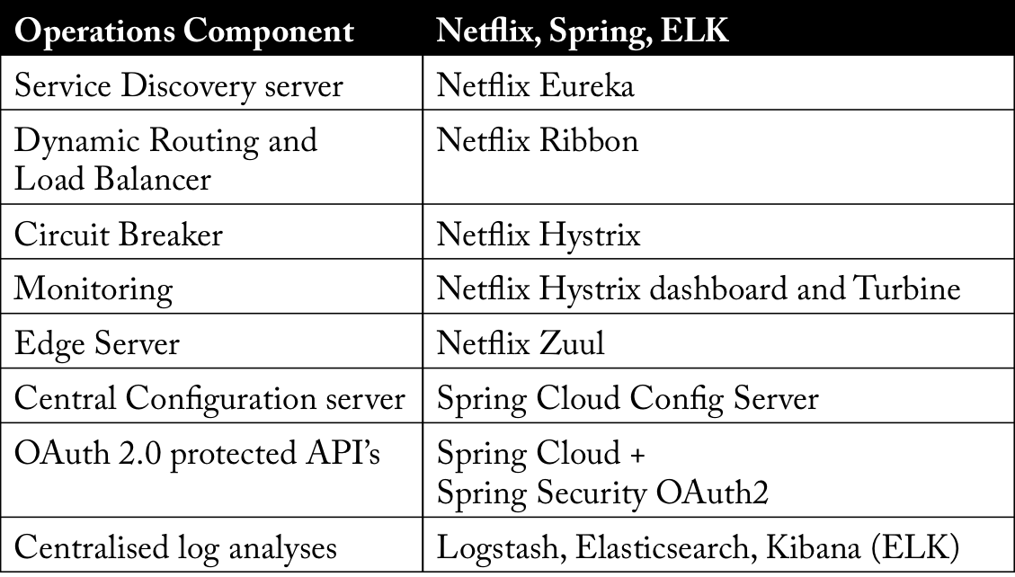
How Spring cloud resolves microservices challenges ?
Configuration Management: Spring Cloud Config.
Service Discovery: Eureka
Dynamic Scale Up and Down: Ribbon as Client Side Load balancer
Visibility and Monitoring: Zipkin Distributed tracing and Netflix API gateway.
API Gateway: Netflix Zuul.
Fault Tolerance: Hystrix.
Notes:
Hystrix is a library, originally developed by Netflix that lets you deal with issues with latency and fault-tolerance in complex, distributed systems

Slide 13
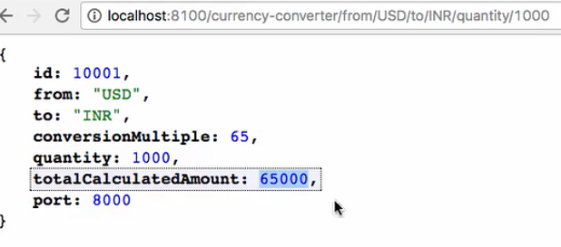
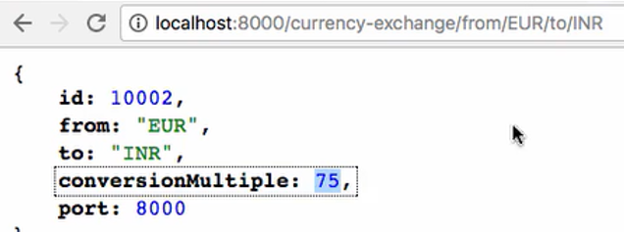
Demo on Spring Boot Microservices with Spring Cloud
CurrencyCalculationService
CurrencyExchangeService
DB

Slide 14
Overview OF demo
CurrencyCalculationService
Port : 8100
Ribbon - Client Side Load Balancer
Eureka Naming Server – Service Discovery and Service Registry
Port : 8761
CurrencyExchangeService
Port : 8000
CurrencyExchangeService
Port : 8001
DB1
DB2

Slide 15
Overview OF demo
Client
API Gateway
Zuul
CurrencyCalculationService
Port : 8100
Ribbon - Client Side Load Balancer
Eureka Naming Server – Service Discovery and Service Registry
Port : 8761
CurrencyExchangeService
Port : 8000
CurrencyExchangeService
Port : 8001
DB1
DB2

Slide 16
Overview OF demo
Client
API Gateway
Zuul
CurrencyCalculationService
Port : 8100
CurrencyExchangeService
Port : 8000
Ribbon, Hystrix
Ribbon, Hystrix
Monitoring Dashboard
-
Hystrix
Eureka Naming Server – Service Discovery and Service Registry
Port : 8761
Config Service
-
Spring Cloud Config

Slide 17
Port & URL for Demo
Application | Port
Currency Exchange Service | 8000, 8001, 8002, ..
Currency Conversion Service | 8100, 8101, 8102, ...
Netflix Eureka Naming Server | 8761
Netflix Zuul API Gateway Server | 8765
Zipkin Distributed Tracing Server | 9411

Slide 18
Port & URL for Demo
Application | URL
Currency Converter Service - Direct Call | http://localhost:8100/currency-converter/from/USD/to/INR/quantity/10
Currency Converter Service - Feign | http://localhost:8100/currency-converter-feign/from/EUR/to/INR/quantity/10000
Currency Exchange Service | http://localhost:8000/currency-exchange/from/EUR/to/INR http://localhost:8001/currency-exchange/from/USD/to/INR
Eureka | http://localhost:8761/
Zuul - Currency Exchange & Exchange Services | http://localhost:8765/currency-exchange-service/currency-exchange/from/EUR/to/INR http://localhost:8765/currency-conversion-service/currency-converter-feign/from/USD/to/INR/quantity/10
Zipkin | http://localhost:9411/zipkin/
Notes:
Netflix provides Feign as an abstraction over REST-based calls, by which microservices can communicate with each other, but developers don't have to bother about REST internal details.
eign, as a client, is an important tool for microservice developers to communicate with other microservices via Rest API.

Slide 19
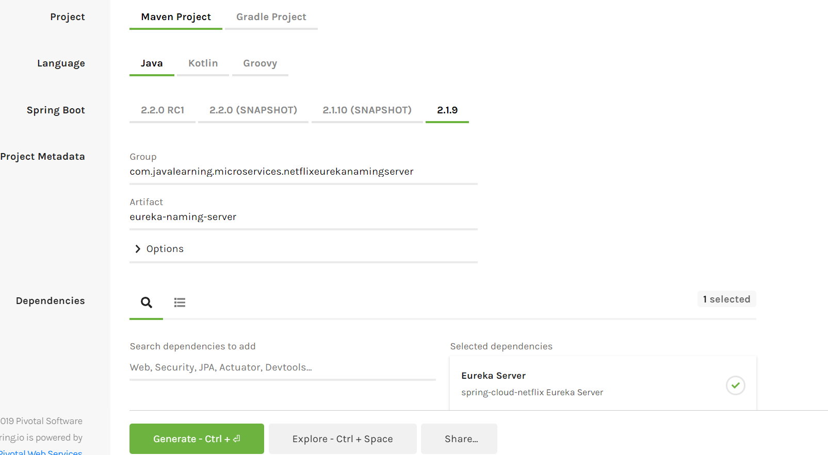
EuREka Server
Dynamically scales up microservices.
It does two things, Service Registry and Service Discovery.
We need to add Eureka Server dependency while setting up the project.

Slide 20
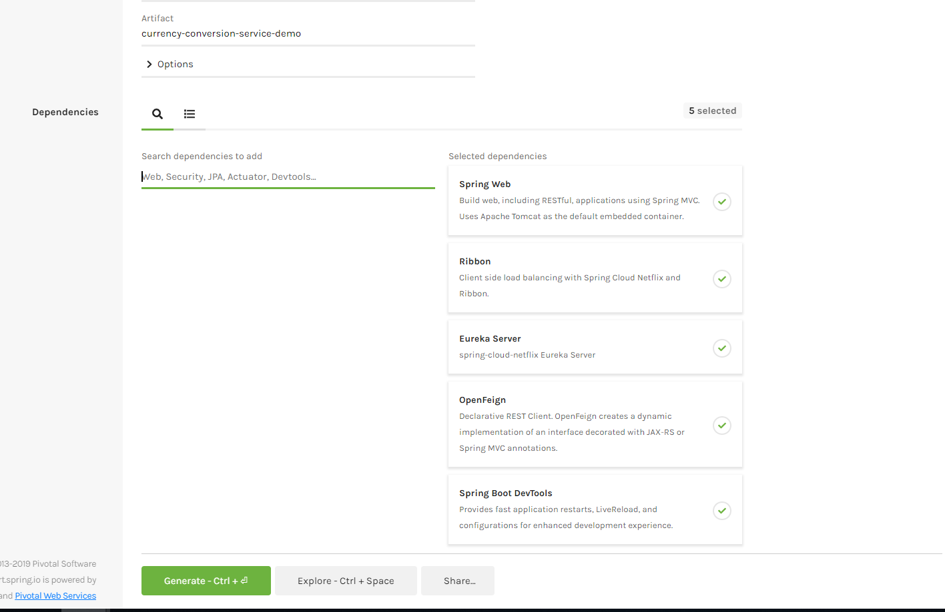
Currency conversion service
.

Slide 21
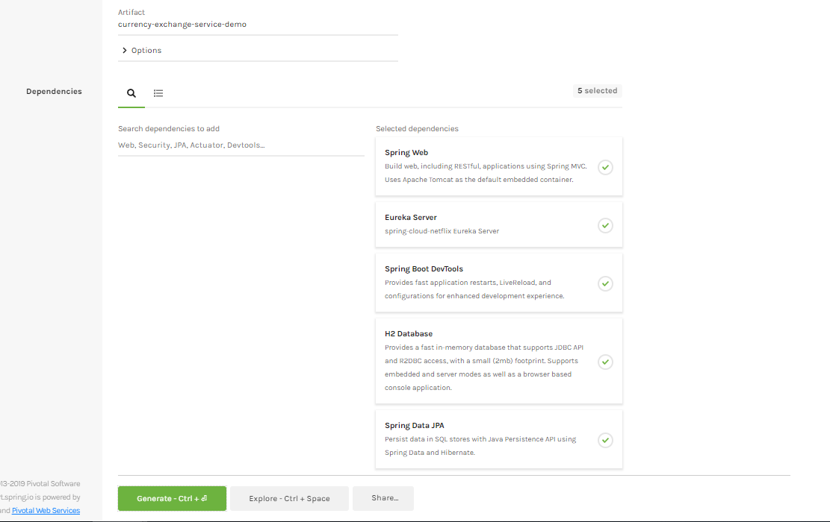
Currency Exchange service
.

Slide 22
Visibility & Monitoring - Zipkin
CurrencyCalculationService
CurrencyExchangeService
Rabbit MQ
ZipkinDistributedTracingServer
Port : 9411
DB

Slide 23
Conclusion
Existing independent features like Market Place Integration and future development like Customer Engagement can be developed as microservice to ensure
loose coupling with other historic functionality.
Scale up or down the new functionality as required
Lesser Development and Test cycles
Develop the microservices either in Spring Boot or any other technology keeping in mind the scalability, monitoring and alerting.

Slide 24
Thank you

